Slide 1
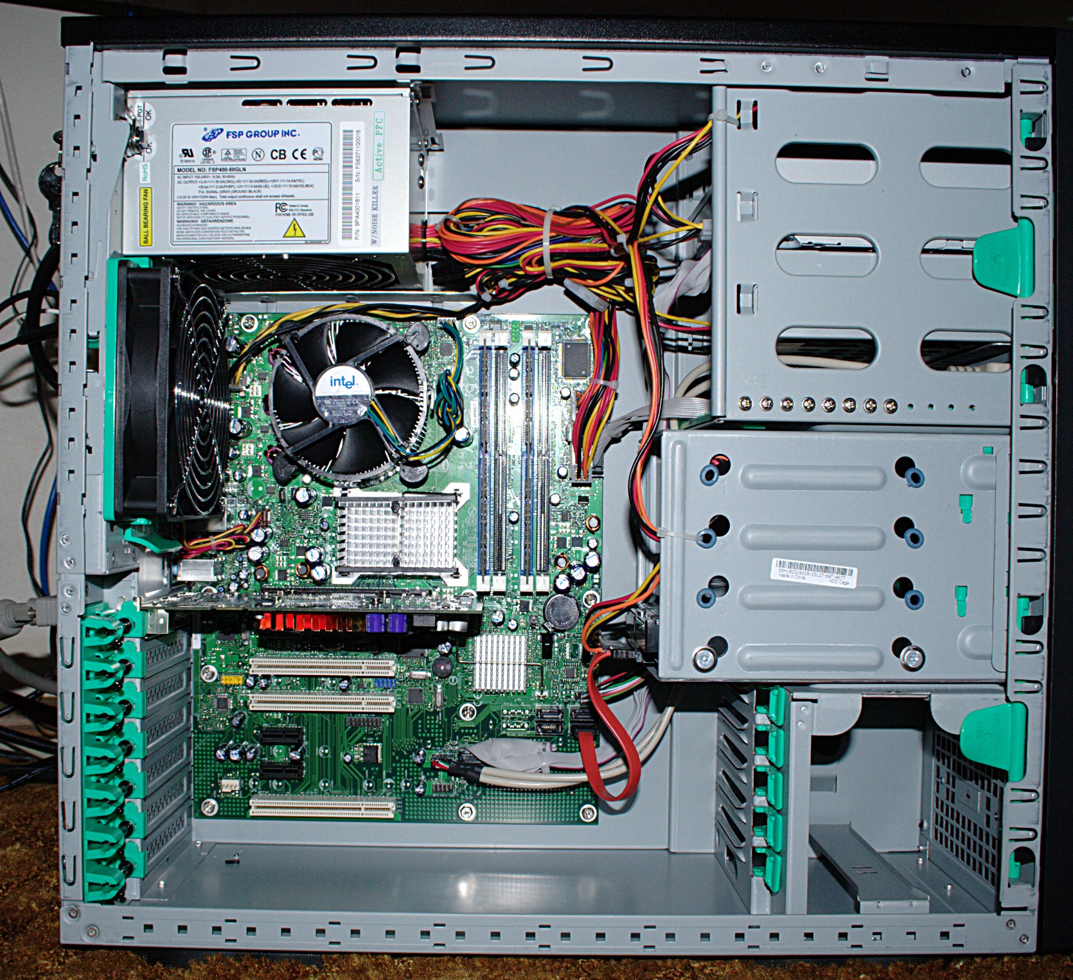
Power Supply
Optional disk drive
Cooling fan
Hard disk drive
Monitor Port
Motherboard
Ethernet port
USB expansion Ports
Audio Port

